Slide 1
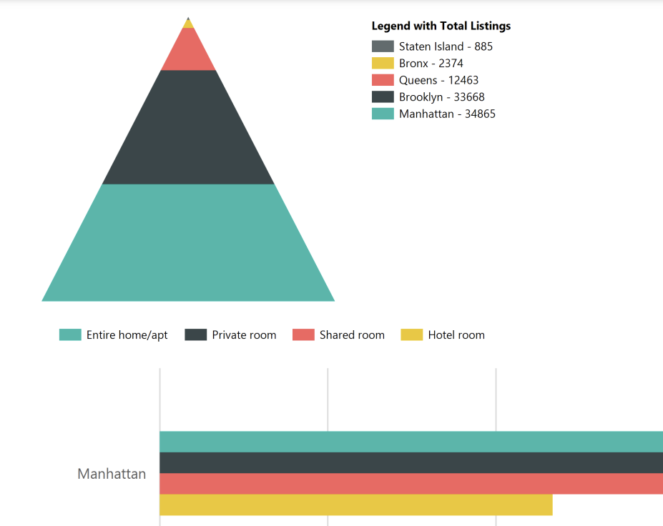
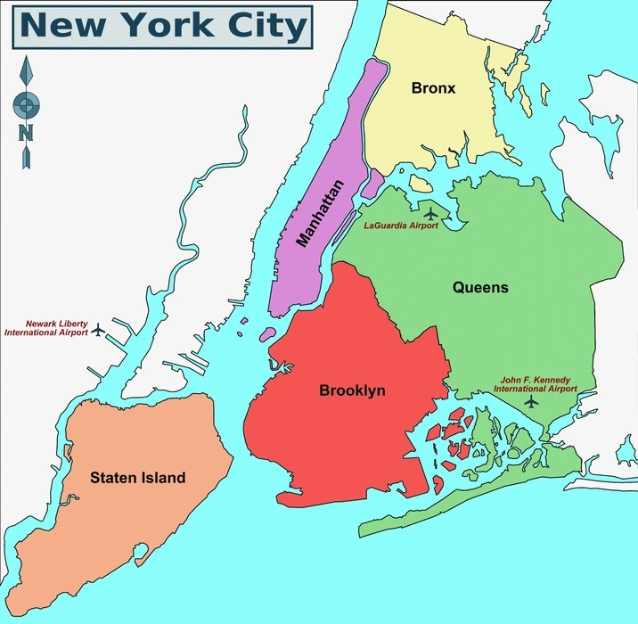
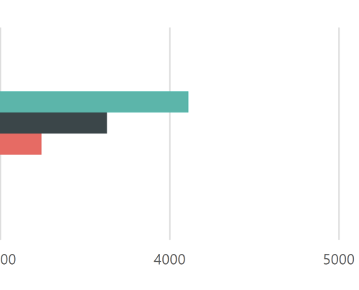

New York City Airbnb
Authors: Joemichael Alvarez, Franchesca Nieves, Tahlia Canovas
Miami Dade College
ABSTRACT
DATA SECTION
RESULTS
CONCLUSION
Guests and hosts have used Airbnb to expand on traveling possibilities and present a more unique, personalized way of experiencing the world. Today, Airbnb became one-of-a-kind service that is used and recognized by the whole world. Data analysis on millions of listings provided through Airbnb is a crucial factor for the company. We decided to focus on the New York City listings in Manhattan, Bronx, Queens, Brooklyn and Staten Island. We analyzed and used the data for an advertising campaign to present better business decisions, understanding of customers' and providers' (hosts) behavior and performance, guiding marketing initiatives, implementation of innovative additional services.
Total Reviews Per Neighborhood: We selected the columns: neighbourhood_group, neighbourhood, room_type, summed the total_reviews and obtained average price of each room. We added a parameter for neighbourhood_group and grouped by the neighbourhood_group, neighbourhood, room_type columns and lastly, ordered by neighbourhood_group, TotalReviews in descending order.
Price Analysis Per Neighborhood: We selected the columns: neighbourhood_group, neighbourhood, minimum and maximum for price and counted all total listings with the sum of total price. We added a parameter for neighbourhood_group and grouped by the neighbourhood_group, neighbourhood columns, we did not want to have any price that was listed with 0 and lastly, ordered by neighbourhood_group, neighbourhood.
Neighbourhood Group Details: We selected the columns: neighbourhood_group, neighbourhood, id, construction_year, price, service_fee, minimum_nights. We used a condition when availability is not 0 then it’s considered available. We did not want to have any construction_year that was listed with 0. We added two parameters for neighbourhood_group and neighbourhood. We then ordered by neighbourhood_group, neighbourhood, id columns.
Total Reviews Per Neighborhood: From the report we can see that Brooklyn and Manhattan have the highest number of reviews, which makes sense as these are the most popular boroughs for travelers. On the other hand, Staten Island and Bronx has the lowest number of reviews, signifying that these places are not popular destinations for travels.
Price Analysis Per Neighborhood: From the report we can see that Long Island City, Queens has the highest total price because it is the former manufacturing epicenter is one of NYC’s most exciting neighborhoods, with a lively nightlife scene, must-visit restaurants and contemporary art museums. And Longwood, Bronx has the lowest total price because it is one of the cities with the highest crime rates and most residents prefer to rent their homes.
Neighbourhood Group Details: This report determines each individual home in its neighbourhood and neighbourhood group with the year it was constructed along with the price, service fee and the availability. It also contains the minimum nights required to rent the Airbnb property.
We can conclude that out of the five boroughs, Manhattan and Brooklyn generate the most traffic and revenue. We would make these two cities the focal point of our advertising campaign to market to new and existing customers, generate more listings, which in return will boost revenue.
REFERENCES
https://www.kaggle.com/datasets/arianazmoudeh/airbnbopendata
02/27/2023

